Slide 1
CONFUSION MATRIX AND KNN
BY MUHAMMAD ADNAN

Slide 2
CONFUSION MATRIX AS AN EVALUATION MODEL

Slide 3
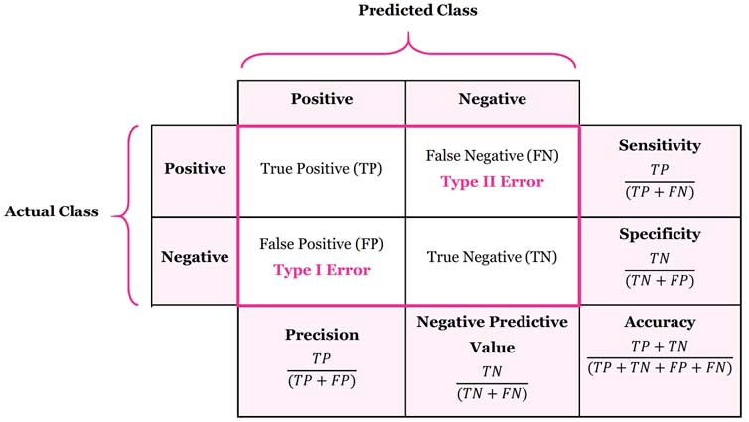
Confusion Matrix

Slide 4
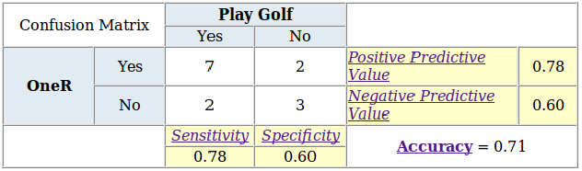

Slide 5
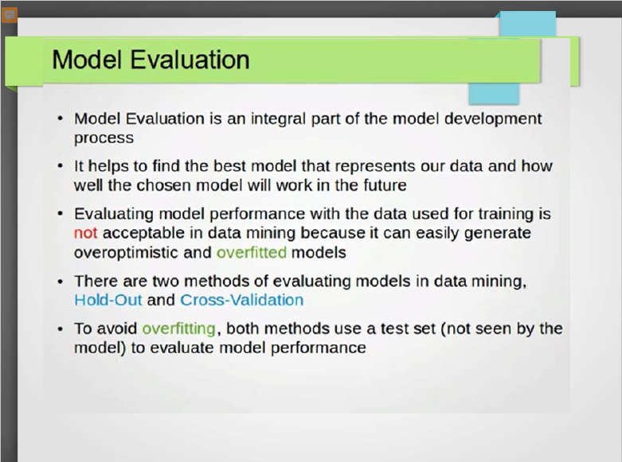

Slide 6
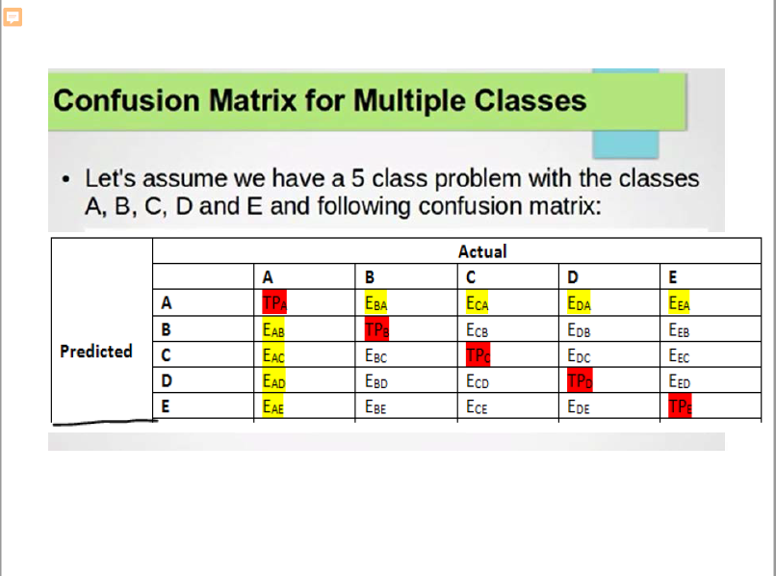

Slide 7
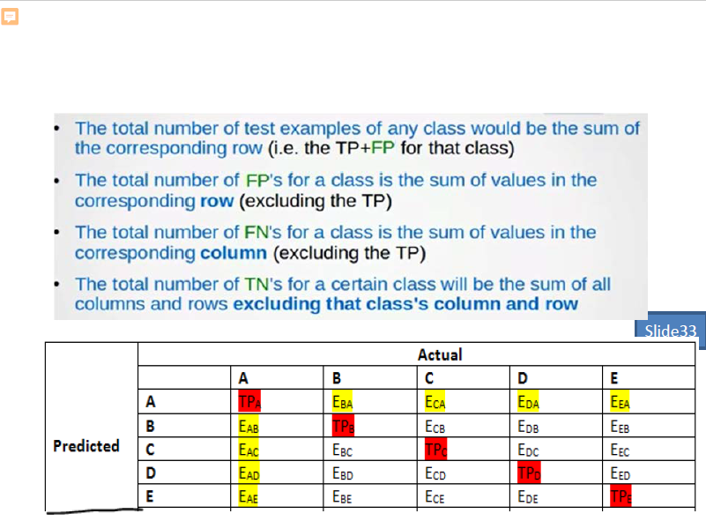

Slide 8
KNN CLASSIFICATION ALGORITHM

Slide 9
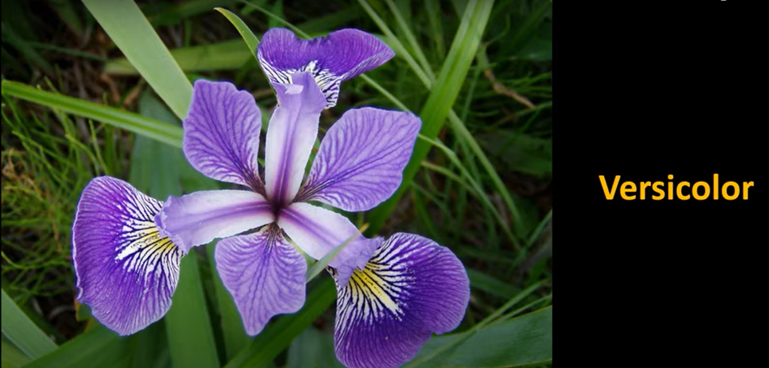
FLOWER INFORMATION

Slide 10
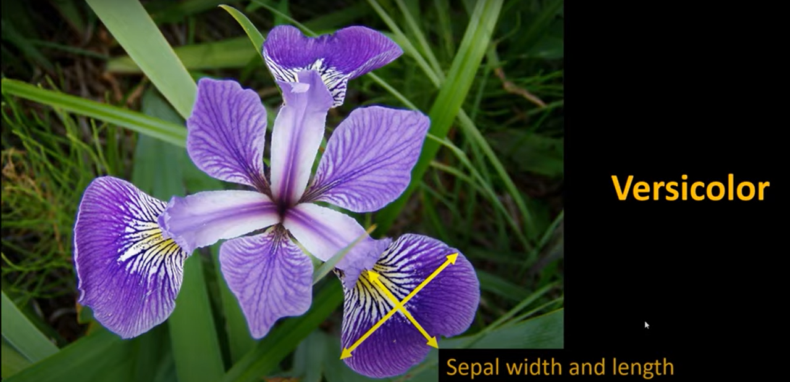
Let we have Sepal info..

Slide 11
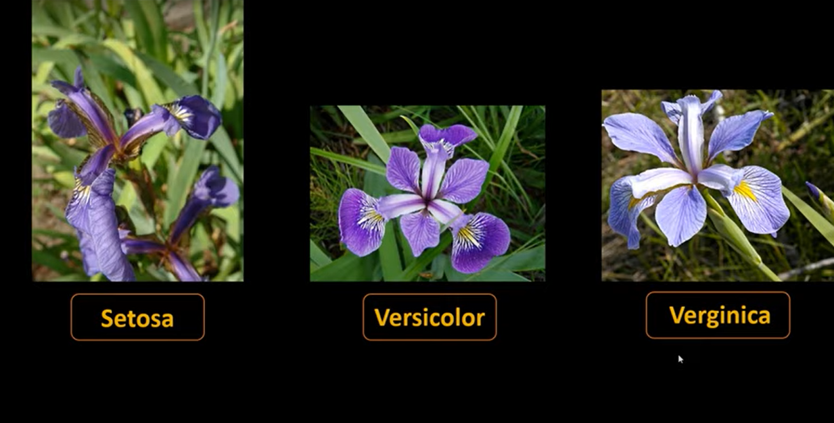
We have three different flowers

Slide 12
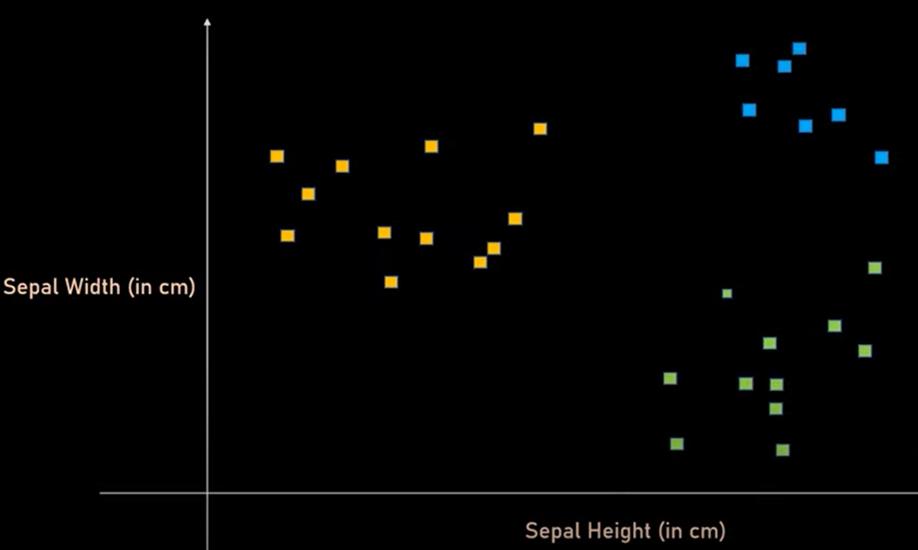
By plotting this info..

Slide 13
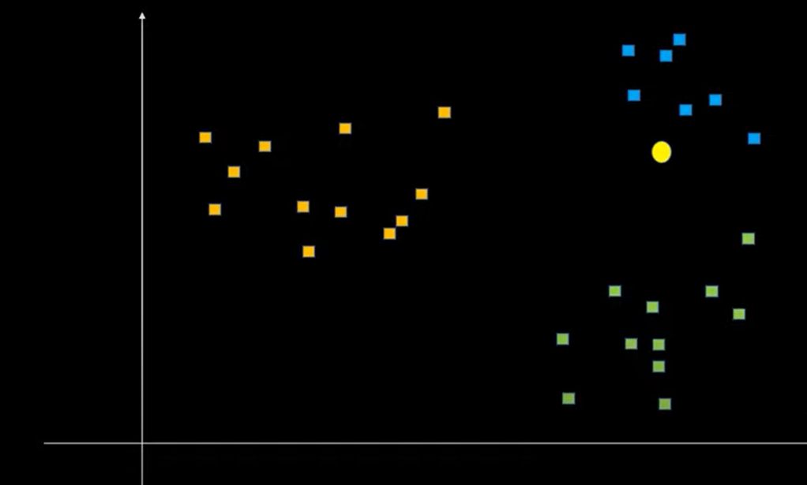
Suppose we have new data of a flower then..

Slide 14
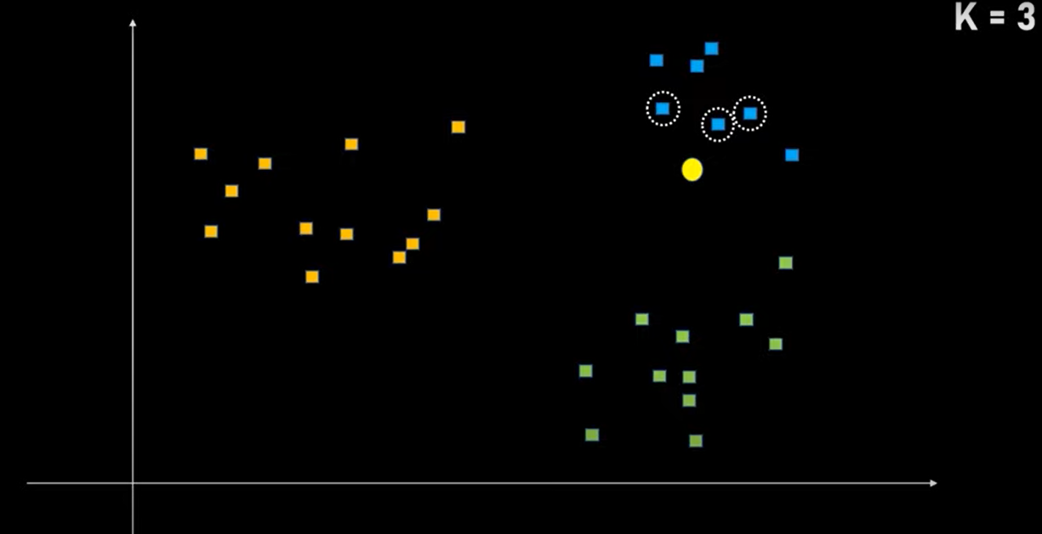
By applying KNN(as K=3)

Slide 15
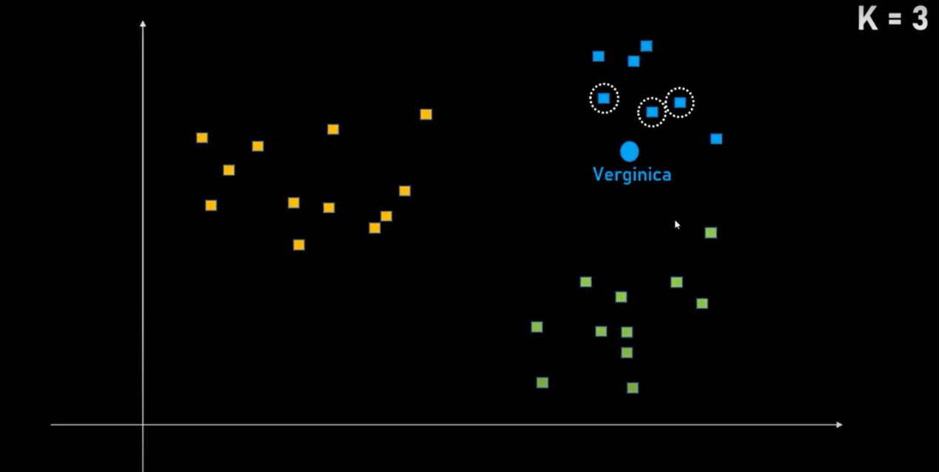
The resultant prediction is Verginica

Slide 16
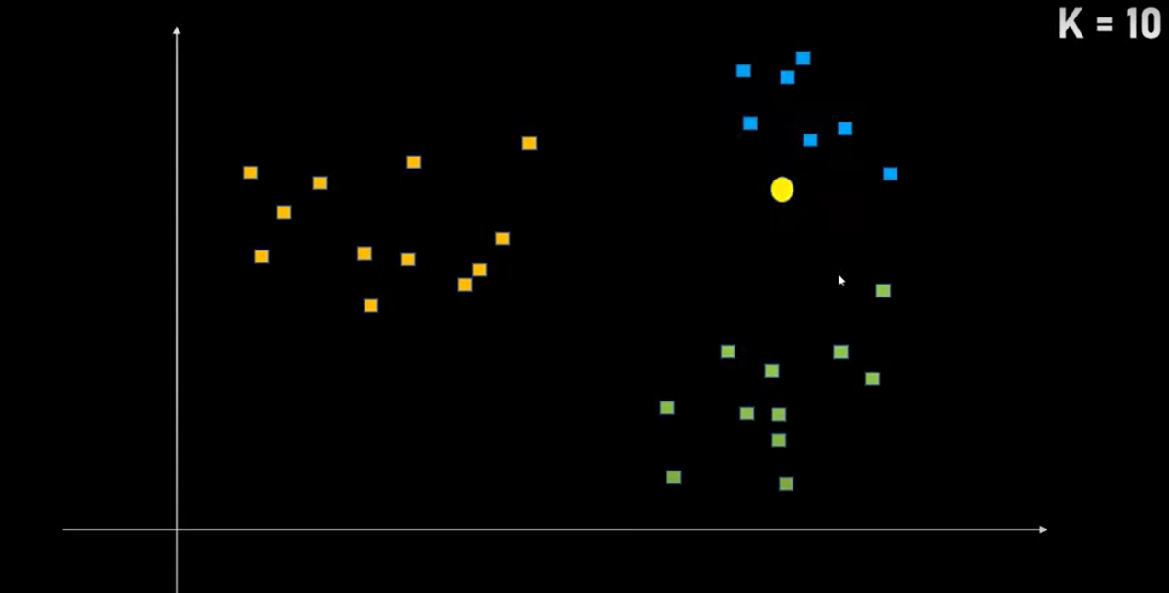
But what if K=10?

Slide 17
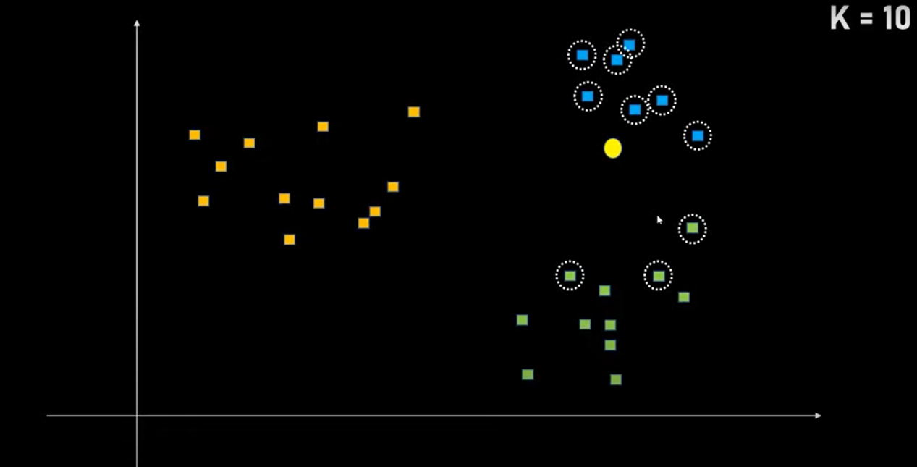
Then we will have the following nearest

Slide 18
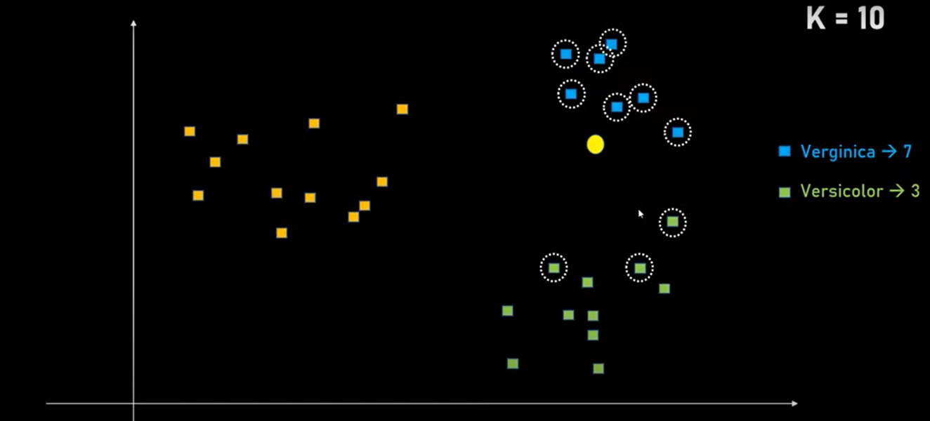
Still the result is Verginica

Slide 19
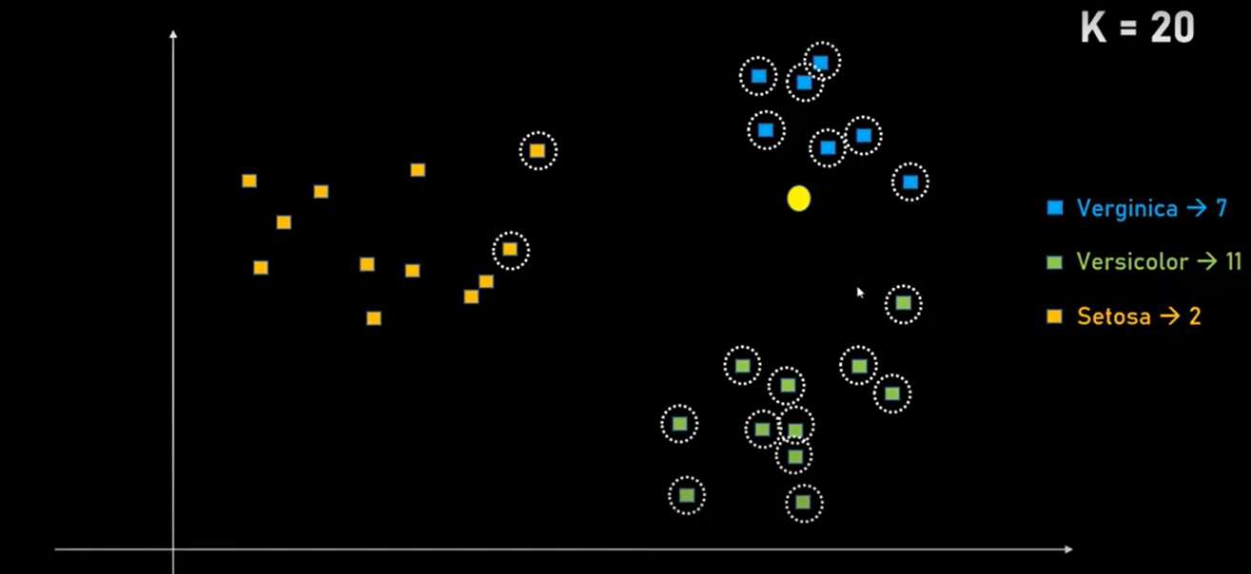
But what for K=20, the result is wrong

Slide 20

Conclusion

Slide 21
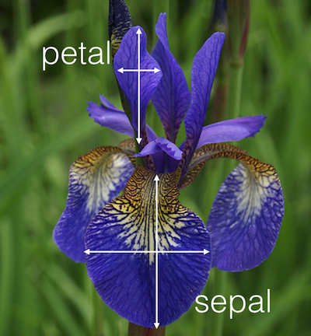
Dataset contains Petal and Sepal info..

